Slide 1
An Attentional Recurrent Neural Network for Personalized Next Location Recommendation
ADVISOR: JIA-LING, KOH
SOURCE: AAAI-20
SPEAKER: WEI, LAI
DATE: 2020/9/10

Slide 2
OUTLINE
Introduction
Method
Experiment
Conclusion

Slide 3
OUTLINE
Introduction
Method
Experiment
Conclusion

Slide 4
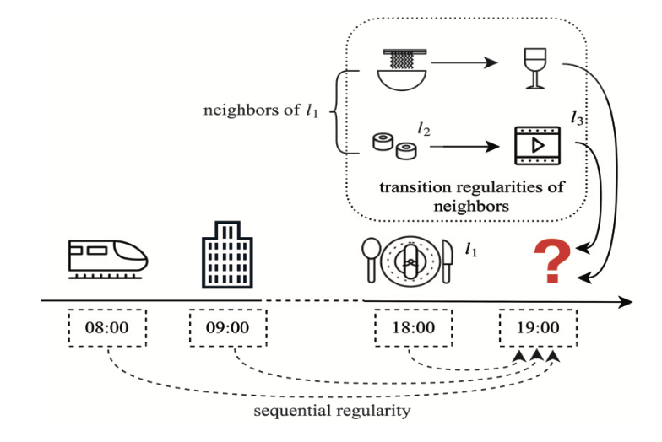
INTRODUCTION
Data Sparsity
Point of Interest (POI)

Slide 5
INTRODUCTION
Geographically close
Describes by the same semantics
Preferred by the same user
Explore the transition regularities of neighbors to resolve the sparsity issue.

Slide 6
OUTLINE
Introduction
Method
Experiment
Conclusion

Slide 7
PROBLEM FORMULATION
Users
Location
POI categories & tags
$$l_{1}$$
$$w_{22}$$
$$U=\{u_{1}, u_{2}, …, u_{\left|U\right|}\}$$
$$L=\{l_{1}, l_{2}, …, l_{\left|L\right|}\}$$
$$V=\{w_{1}, w_{2}, …, w_{\left|V\right|}\}$$
$$u_{1}$$
$$w_{2}$$
$$His( )$$
$$=\{r_{1}, r_{2}, …, r_{H}\}$$
$=\{\left(u_{1}, l_{1}, t_{1}\right), …, \left(u_{1}, l_{k}, t_{k}\right),…, (u_{1}, l_{H}, t_{H})$}
Historical sequence
Check-in
$$S( )=\{ \}$$
Semantics

Slide 8
PROBLEM FORMULATION
$$u_{1}$$
$$His( )$$
$$=\{r_{1}, r_{2}, …, r_{H}\}$$
Historical sequence
Check-in
$$\{l_{5}, l_{11}, …, l_{7}\}$$
$$u_{1}$$
A list of locations that would visit at time step $t_{K}$
< 12h
< 12h
$$u_{1}$$
$$Tra( )$$
$$=\{r_{1}, r_{2}, …, r_{K−1}\}$$
Trajectory

Slide 9
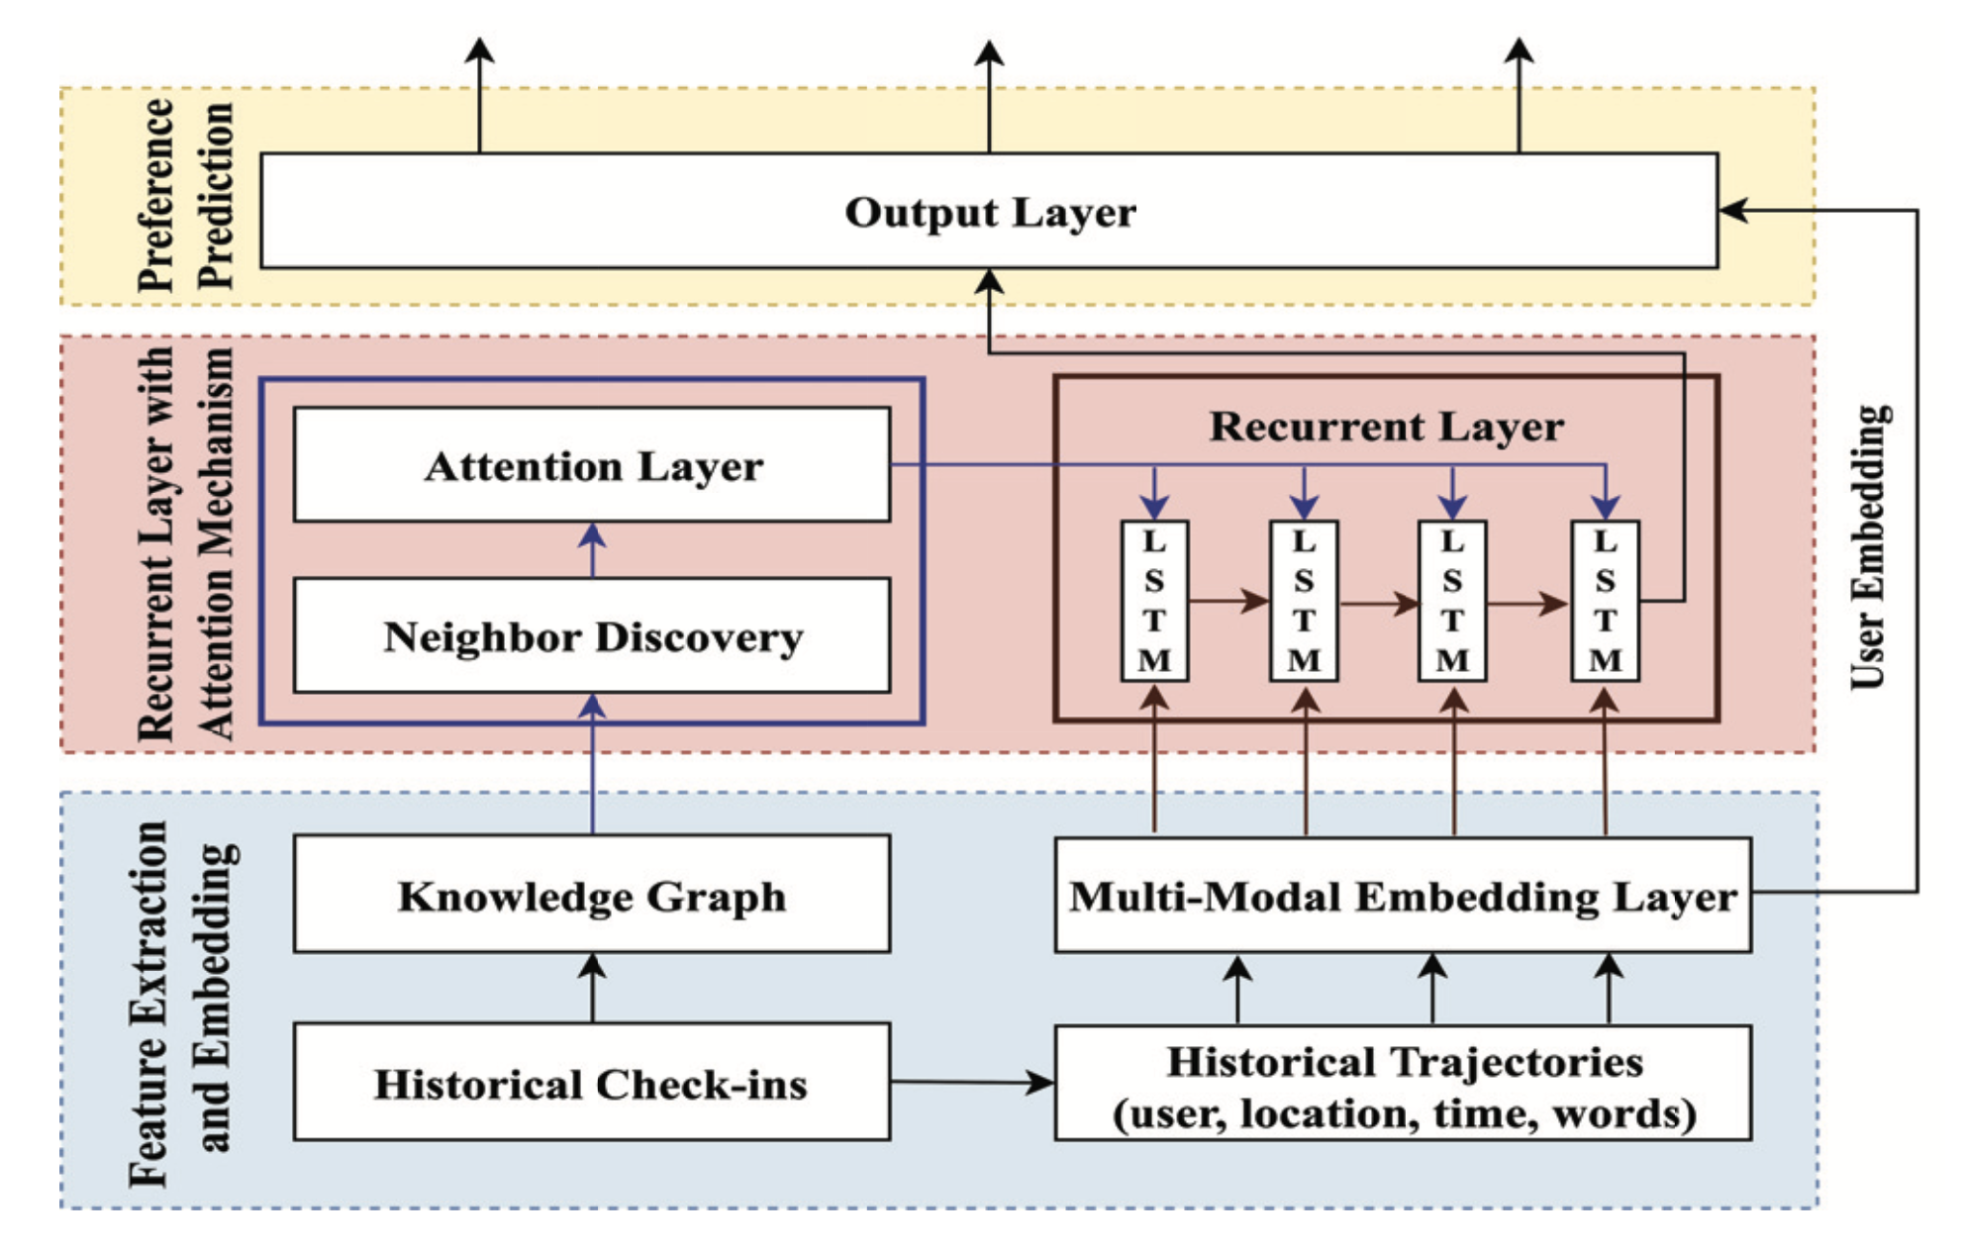
METHOD: Attentional Recurrent Neural Network

Slide 10
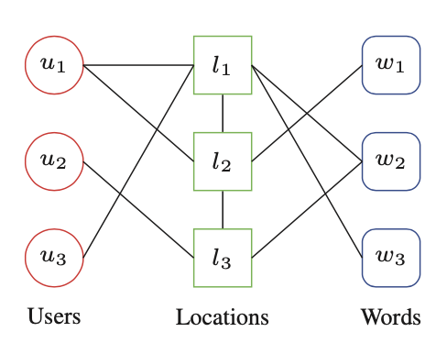
METHOD: Attentional Recurrent Neural Network

Slide 11
METHOD: Attentional Recurrent Neural Network

Slide 12
MULTI-MODAL EMBEDDING LAYER
$$u$$
$$Tra( )$$
$$=\{r_{1}, r_{2}, …, r_{K−1}\}$$
$=\{\left(u_{1}, l_{1}, t_{1}\right), \left(u_{1}, l_{2}, t_{2}\right),…, (u_{1}, l_{K−1}, t_{K−1})$}
1 | 0 | … | 0
1 | 2 | … | 9 | 0
$$\dim{= \left|V\right|}$$
$$\dim{= \left|U\right|}$$
1 | 5 | … | 0 | 5
0 | 0 | … | 1 | 0
$$S\left(l_{1}\right)={\{w}_{2}, w_{22}\}$$
1 | 0 | … | 0 | 0 | 0
2 | 1 | … | 0 | 0
0 | 1 | … | 1 | 0
$$\dim{= \left|L\right|}$$
0 | 3 | … | 1 | 3
0 | 1 | … | 0 | 0
Embedding layer
$$\dim{=120 or 160}$$
1 | 0 | … | 0 | 0
$$\dim{=24}$$

Slide 13
METHOD: Attentional Recurrent Neural Network

Slide 14
NEIGHBOR DISCOVERY
PathSim: Meta Path-Based Top-K Similarity Search in Heterogeneous Information Networks (Sun et al. 2011)
$$G$$

Slide 15
METHOD: Attentional Recurrent Neural Network

Slide 16
ATTENTION LAYER
$$e_{l_{k}}$$
$$e_{l_{1}}$$
$$e_{l_{2}}$$
$$e_{l_{3}}$$
$$e_{l_{4}}$$
$$a_{k}(2)$$
$$a_{k}(3)$$
$$a_{k}(4)$$
$$a_{k}(1)$$
$${=softmax(f}_{a}(e_{l_{k}}, e_{l_{1}}))$$
$$c_{k}$$
$$=softmax(tanh {(e_{l_{k}}^{T}∙W_{a}∙e}_{l_{1}}))$$
Weighted average embedding over all the neighbors
$$a_{k}(1)e_{l_{1}}$$
$$a_{k}(2)e_{l_{2}}$$
$$a_{k}(3)e_{l_{3}}$$
$$a_{k}(4)e_{l_{4}}$$

Slide 17
METHOD: Attentional Recurrent Neural Network

Slide 18
RECURRENT LAYER
$$e_{k}=[e_{l_{k}};e_{t_{k}};e_{s_{k}};c_{k}]$$
$$h_{k}=f(W_{r_{1}}∙h_{k−1}+W_{r_{2}}∙e_{k}+b_{r})$$
hidden state at k

Slide 19
METHOD: Attentional Recurrent Neural Network

Slide 20
OUTPUT LAYER
$$e_{u}$$
$$o_{K−1}$$
$$h_{K−1}$$
$$o_{K−1}=W_{o_{1}}∙h_{K−1}+b_{o_{1}}$$
dim = $D_{u}$
dim = $D_{h}$
$${o′}_{K−1}=W_{o_{2}}\left[\begin{matrix}o_{k−1} \\ e_{u}\end{matrix}\right]+b_{O_{2}}$$
$${\hat{y}}_{K}^{u_{i}}=softmax({o′}_{K−1})$$

Slide 21
MODEL OPTIMIZATION
Ground truth
(one-hot vector)
Predict
(probability distribution over L)

Slide 22
OUTLINE
Introduction
Method
Experiment
Conclusion

Slide 23
DATASET

Slide 24
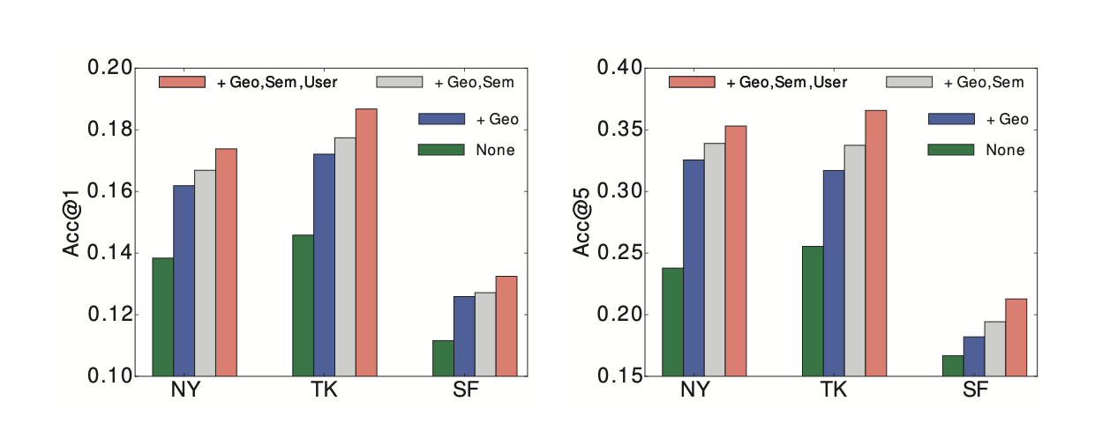
ANALYSIS OF META-PATHS

Slide 25
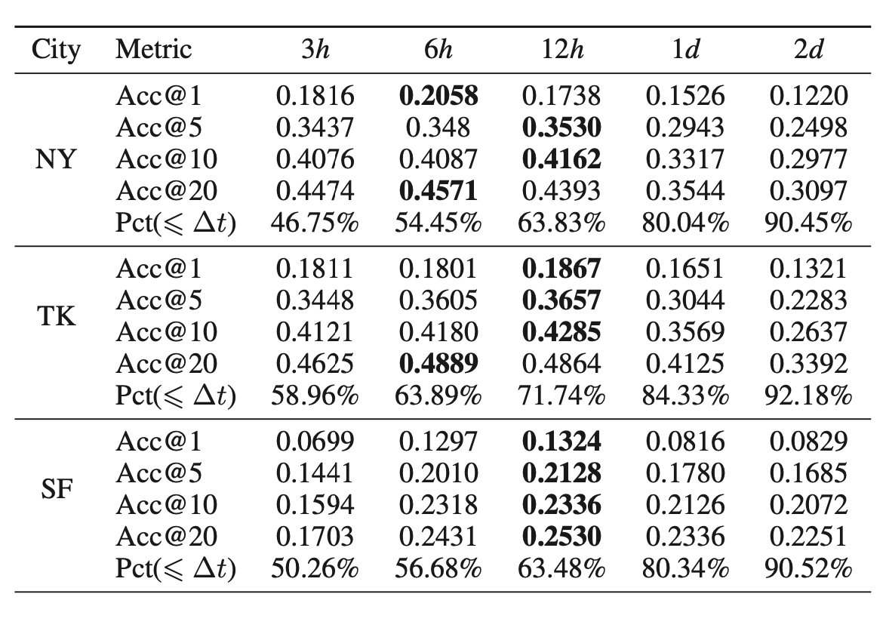
ANALYSIS OF TIME THRESHOLD

Slide 26
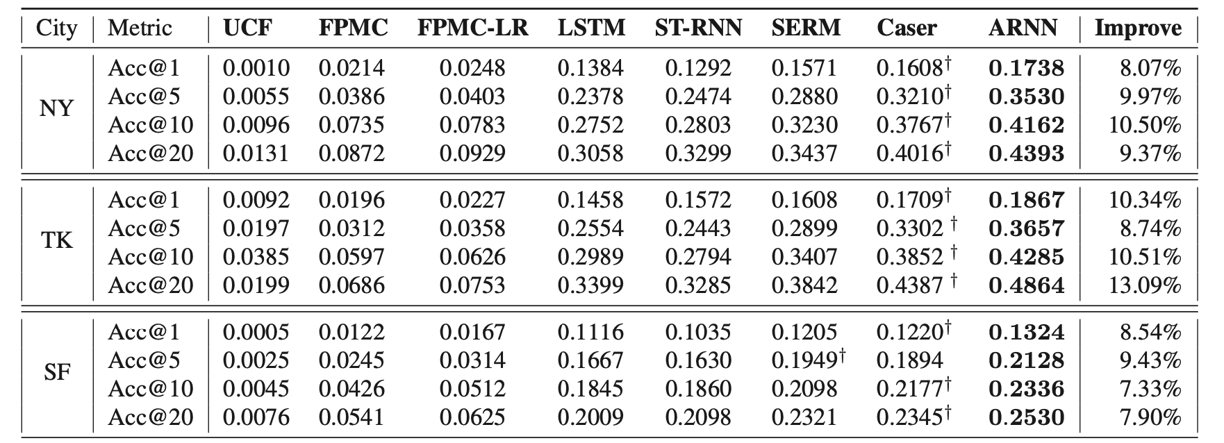
COMPARARIVE RESULTS

Slide 27
OUTLINE
Introduction
Method
Experiment
Conclusion

Slide 28
CONCLUSION
Design a meta-path based random walk on novel KG to discover relevant neighbors based on heterogenous factors.
Jointly model both sequential regularity and transition regularities of neighbors by proposing ARNN.
Future work: explore more useful data sources such as weather and traffic information.

